Slide 1

DEPARTMENT OF COMPUTER SCIENCE AND ENGINEERING
Project name : Public Transport Optimization
Team name : Proj_224782_Team_4
Team members :
ASHWINI E(113321104006)
BENSIHA A(113321104008)
DEYAA ASMI M(113321104013)
DHANALAKSHMI S(113321104014)

Slide 2
PROJECT
Optimizing public transport with IoT (Internet of Things) involves using smart devices and data analytics to enhance efficiency, safety, and passenger experience.
This project meets the evolving needs of the community while reducing traffic congestion and environmental impact. IoT can play a pivotal role in making public transport more efficient, convenient, and sustainable.

Slide 3
PLATFORM REQUIRED
API Integration: Supporting open APIs for third-party developers to create complementary apps and services.Route Optimization
Real-Time Data Integration: The platform should be capable of collecting and integrating real-time data from various sources, such as GPS tracking, passenger counting sensors, and traffic management systems.
Route Optimization: Algorithms for optimizing routes, schedules, and stop locations to minimize travel time and improve service reliability.
Demand Forecasting: Using data analytics to predict passenger demand and adjust services accordingly.
Traffic Management: Integrating with traffic control systems to prioritize public transport vehicles and reduce congestion.

Slide 4
WEB DEVELOPMENT TECHNOLOGIES
Front-End Development:
HTML5 and CSS3:For creating the structure and styling of web pages.
JavaScript: For interactive features and real-time updates on web applications.
React, Angular, or Vue.js: Popular JavaScript libraries/frameworks for building responsive, user-friendly interfaces.
Back-End Development:
Node.js, Python, Ruby, or Java: Backend server technologies to handle data processing, logic, and communication with databases.
Express.js, Django, Ruby on Rails, or Spring Boot: Frameworks that simplify back-end development.
Geospatial Technologies:
GeoJSON: A format for encoding geospatial data often used in web applications.
OpenLayers, Leaflet: Libraries for displaying interactive maps on web pages.

Slide 5
Databases:
MySQL, PostgreSQL, MongoDB: Storing and managing structured and unstructured data relevant to public transport operations.
GIS (Geographic Information System) Databases:For handling geospatial data such as routes and locations.
HTTPS: Secure data transmission over the web.
Authentication and Authorization:Implementing user access controls and securing sensitive data.
Real-Time Data:
WebSockets: Enabling real-time data updates and notifications to passengers and operators.
MQTT (Message Queuing Telemetry Transport): Useful for IoT-based real-time data streaming and communication.

Slide 6
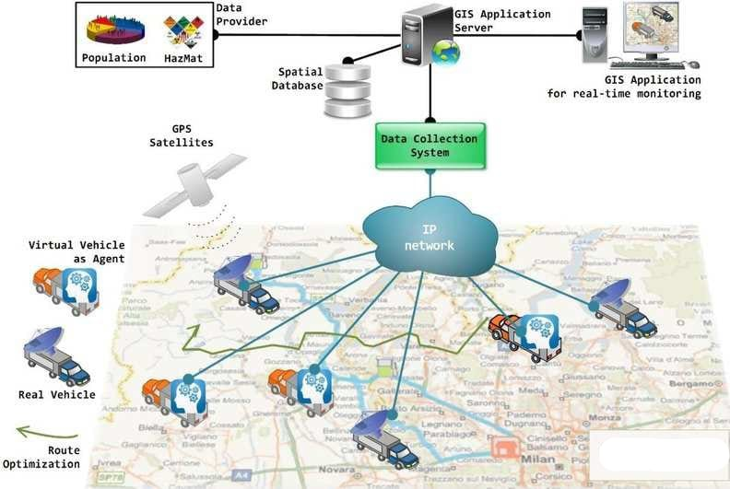
IOT SENSOR SETUP

Slide 7
CONCLUSION
The public transport optimization is a critical area where modern technologies, including IoT and web development, can make a significant impact. By leveraging IoT for real-time data collection and analysis, public transportation systems can enhance efficiency, safety, and the overall passenger experience. Meanwhile, web development technologies play a key role in building user-friendly applications and systems that provide real-time information, route planning, and seamless passenger services. The successful integration of these technologies can lead to more sustainable, accessible, and efficient public transportation networks that benefit both passengers and operators. As technology continues to advance, public transport optimization will likely become even more sophisticated and effective, contributing to the improvement of urban mobility and reducing environmental impact.

Slide 8
THANK YOU

